Slide 1

Changing the Narrative: Racial and Ethnic Variations in Positive Interactions between Prison Staff and Incarcerated Women
Alexis Klemm, B.S.
School of Criminology and Criminal Justice
Arizona State University
aklemm@asu.edu

Slide 2
What general themes emerge from the responses to the question “tell me about your best experience with a staff member at this prison”?
Are there variations in themes based on racial/ethnic identity of respondents?

Slide 3
Procedural Justice & Legitimacy
Perceptions of procedural justice impact the way people within the system choose to engage with the system and whether they perceive it as legitimate
(van Hall et al., 2022; Barkworth & Murphy, 2021; Reisig & Mesko, 2009)
Previous studies have looked at this nuance in staff-incarcerated interactions and perceptions of authority
(Crewe et al., 2015; Beijersbergen et al., 2015)
Effects of race on perceptions of procedural justice and legitimacy
(Johnson et al., 2017; Atkin-Plunk et al., 2019; Solomon, 2019; Wheelock et al., 2019)
Instrumentality & Relationality
(Lind & Tyler, 1988; Tyler & Lind, 1992; Tyler, 1989; Tyler, 1997)

Slide 4
Data
“tell me about your best experience with a staff member at this prison”
“what would you identify as your race or ethnicity?”
White
Black or African American
Hispanic
American Indian or Alaskan Native
Asian
Native Hawaiian or Other Pacific Islander
Other

Slide 5
Method
200 responses uploaded to Atlas.ti. All 200 responses reviewed by two graduate student coders
Each coder open-codes initial 20% of responses
Coders meet to discuss coding decisions and establish coding scheme
Each coder re-coded initial 20% of responses based on established coding scheme
Coders meet to calculate intercoder agreement
Remaining 80% of responses was split between two coders to be coded using the established coding scheme
Coders met to create thematic groupings of codes, creating major themes and subthemes

Slide 6
What general themes emerge?
Kindness and Support from Staff (51.5%, n=103) | Practical Assistance from Staff (31%, n=62) | Treated with Humanity and Respect (21%, n=42) | Staff Effort and Responsiveness (17%, n=34)
Concern or compassion for women (n=35) | Helpfulness from staff in general (n=23) |  | Staff positive attitudes and optimism (n=15)
Encouragement or emotional support from staff (n=27) | Assistance with programming or education (n=17) |  | Staff exceeds women’s expectations (n=11)
Recognition, appreciation, or opportunities from staff (n=17) | Assistance with medical needs (n=16) |  | Staff professionalism and accountability (n=8)
Good communication with staff (n=10) | Assistance with finding and/or maintaining employment (n=6)
Staff advocate or stand up for women (n=9)
Patience from staff (n=5)
“a staff member comforted me when I had a death in the family” | “really helpful every day. If we need something she is there for us” | “treating me not like an inmate but an equal human being” | “upbeat, uplifting, always makes your day better especially when you’re having a bad day”

Slide 7
Racial variations across themes – White/Non-white
Major Theme | White (n=88) | Non-white (n=112)
Kindness and Support from Staff (n=103) | 53.4% (n=47) | 50% (n=56)
Practical Assistance from Staff (n=62) | 35.2% (n=31) | 27.7% (n=31)
Treated with Humanity and Respect (n=42) | 19.3% (n=17) | 22.3% (n=25)
Staff Effort and Responsiveness (n=34) | 19.3% (n=17) | 15.2% (n=17)

Slide 8
Racial variations across themes – White/Hispanic
Major Theme | White (n=88) | Hispanic (n=58)
Kindness and Support from Staff (n=103) | 53.4% (n=47) | 43.1% (n=25)
Practical Assistance from Staff (n=62) | 35.2% (n=31) | 27.6% (n=16)
Treated with Humanity and Respect (n=42) | 19.3% (n=17) | 22.4% (n=13)
Staff Effort and Responsiveness (n=34) | 19.3% (n=17) | 18.9% (n=11)

Slide 9
Discussion
Themes relate back to these ‘instrumentality’ and ‘relationality’ models of Procedural Justice Theory
White respondents’ heightened interest in simply having their needs met
Non-white respondents’ heightened appreciation for acts that are indicative of respect and value of status

Slide 10
Limitations
Selection bias due to non-random sample
White/non-white is very broad
Racial identity is not inherently reflective of experiences of racial stigma and discrimination
Do not know the race of staff

Slide 11
Next Steps
Plan to further collapse themes into categories of ‘relational’ and ‘instrumental’ to determine likelihood of reporting different types of support by race
Kindness and Support from Staff & Treated with Humanity and Respect > Relational
Practical Assistance from Staff & Staff Effort and Responsiveness > Instrumental
Plan to recode race and expand race categories for analyses

Slide 12
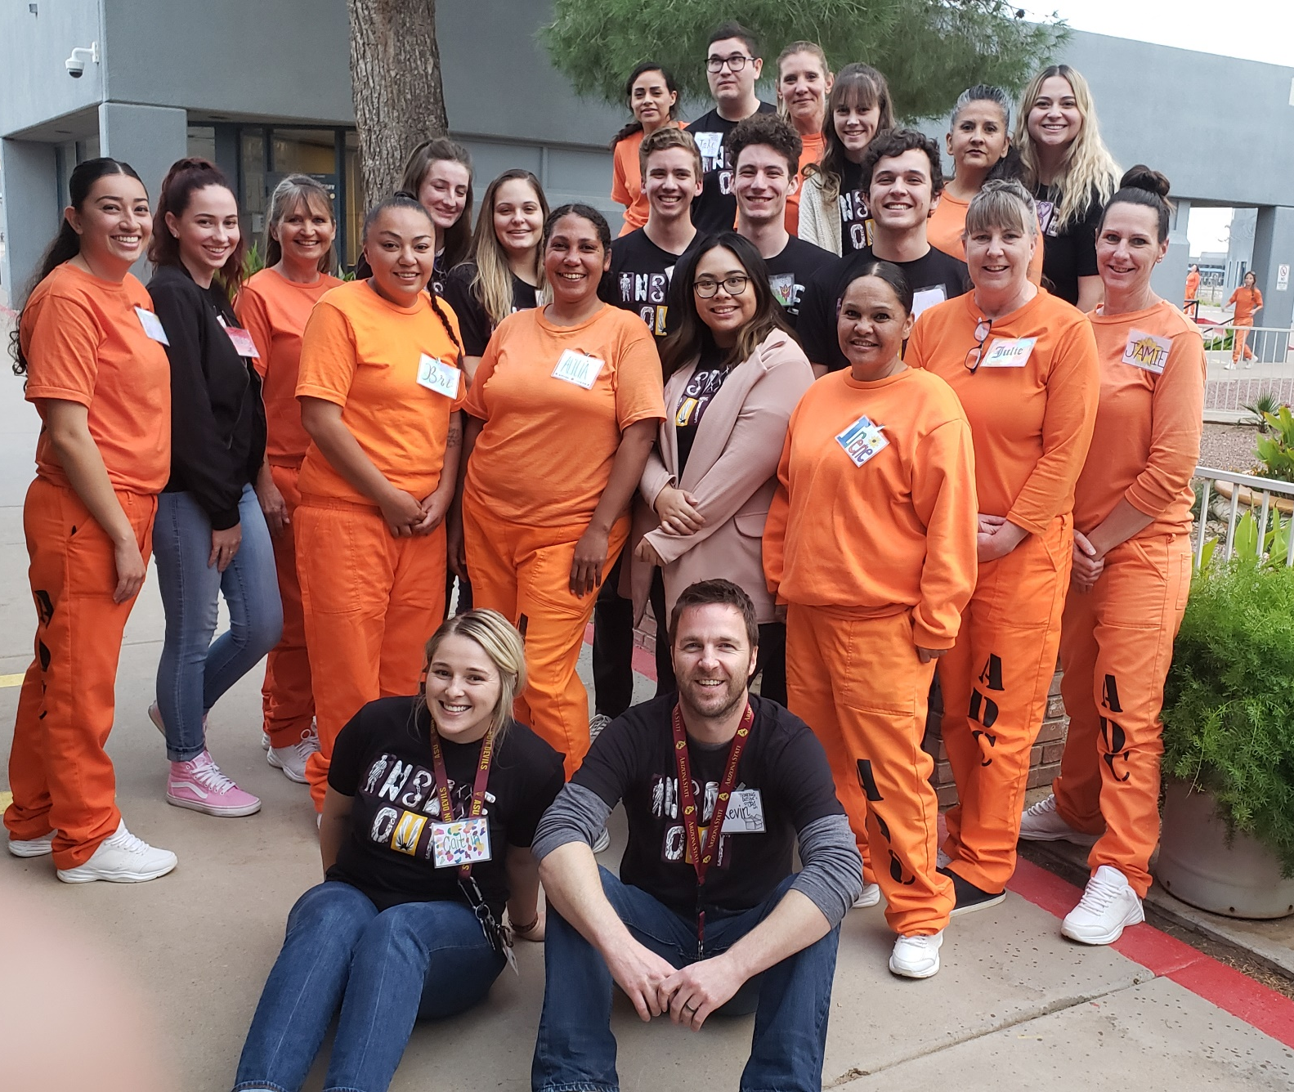
“A teacher in GED class had so much faith in me. He didn't push too hard, but I could tell he saw the potential in me when I didn't see it in myself. He never gave up on me."
2019 Inside Out Prison Exchange Program Class,
ASPC-Perryville

Slide 13
Thank you!
Alexis Klemm, B.S.
Email: aklemm@asu.edu
Twitter: @AlexisKlemm

Slide 14
Additional Themes
Many Positive Experiences (6%, n=12) | No Best Experience (12%, n=24) | Negative or Mixed Experiences (4.5%, n=9) | Don’t Know or Skipped (2.5%, n=5)

Slide 15
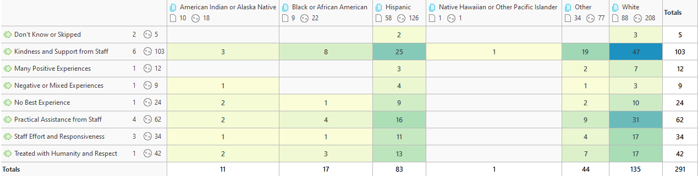
Full Results

